Slide 1

Assessing Clustering Tendency

Slide 2
Assessing Clustering Tendency
Before applying any clustering algorithm to a data set, the first thing to do is to assess the clustering tendency. That is, whether applying clustering is suitable for the data.
If yes, then how many clusters are there.
Next, you can perform hierarchical clustering or partitioning clustering (with a pre-specified number of clusters).

Slide 3
Assessing Clustering Tendency
Before applying any clustering method on your data, it’s important to evaluate whether the data sets contains meaningful clusters (i.e.: non-random structures) or not.
The process is defined as the assessing of clustering tendency or the feasibility of the clustering analysis.

Slide 4
Assessing Clustering Tendency
One way to assess whether data contains any meaningful clusters is through visualizations.
If the data contain more than two variables, we need to reduce the dimensionality in order to plot a scatter plot.

Slide 5
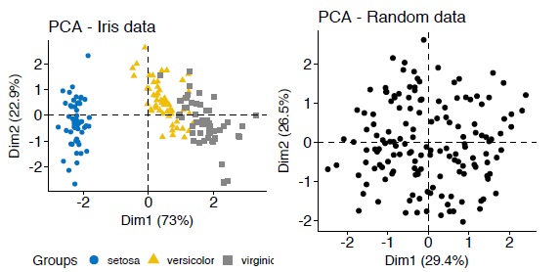
Assessing Clustering Tendency

Slide 6
Statistical Methods
We discuss two methods for evaluating the clustering tendency: i) a statistical (Hopkins statistic) and ii) a visual methods (Visual Assessment of cluster Tendency (VAT) algorithm).

Slide 7
Hopkins Statistic
The Hopkins statistic is used to assess the clustering tendency of a data set by measuring the probability that a given data set is generated by a uniform data distribution. In other words, it tests the spatial randomness of the data.
For example, let D be a real data set. The Hopkins statistic can be calculated as follow:

Slide 8
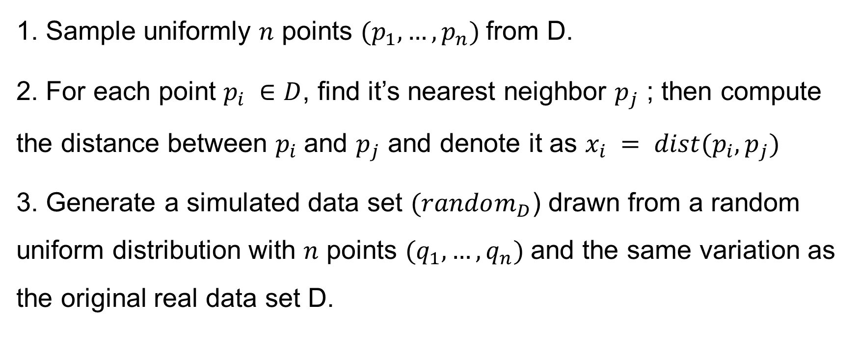
Hopkins Statistic
1. Sample uniformly $n$ points $(p_{1},…, p_{n})$from D.
2. For each point $p_{i} ∈$ $D$, find it’s nearest neighbor $p_{j}$ ; then compute the distance between $p_{i}$and $p_{j}$ and denote it as $x_{i} = dist(p_{i}, p_{j})$
3. Generate a simulated data set $(random_{D}$) drawn from a random uniform distribution with $n$ points $(q_{1},…, q_{n})$and the same variation as the original real data set D.

Slide 9
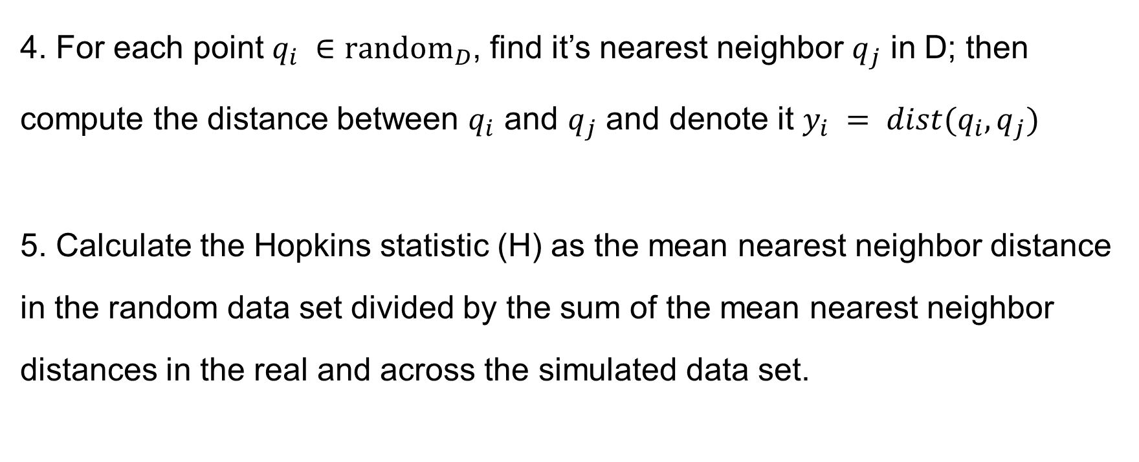
Hopkins Statistic
4. For each point $q_{i} ∈$ ${random}_{D}$, find it’s nearest neighbor $q_{j}$ in D; then compute the distance between $q_{i}$ and $q_{j}$ and denote it $y_{i} = dist(q_{i}, q_{j})$
5. Calculate the Hopkins statistic (H) as the mean nearest neighbor distance in the random data set divided by the sum of the mean nearest neighbor distances in the real and across the simulated data set.

Slide 10

Hopkins Statistic
The formula is defined as follow:
$$H=\frac{\sum_{i=1}^{n}{y_{i}}}{\sum_{i=1}^{n}{x_{i}}+\sum_{i=1}^{n}{y_{i}}}$$

Slide 11
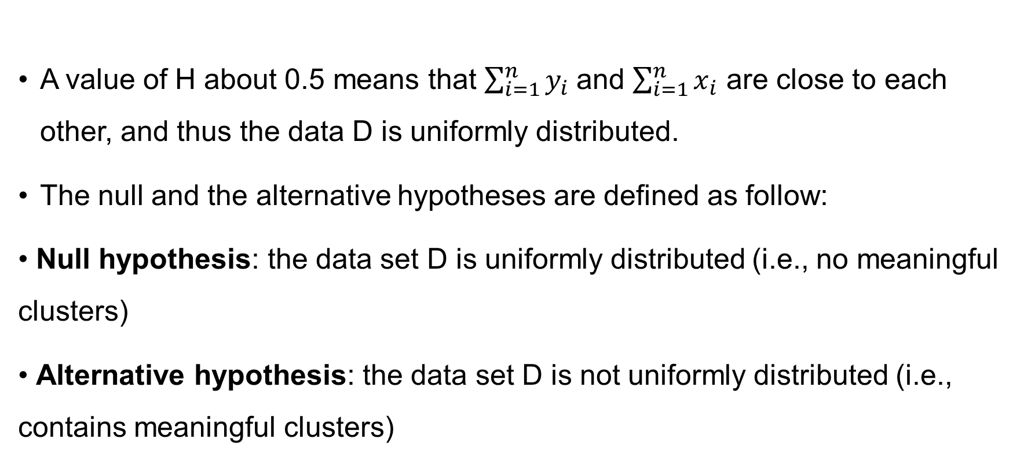
Hopkins Statistic
A value of H about 0.5 means that $\sum_{i=1}^{n}{y_{i} }$and $\sum_{i=1}^{n}{x_{i}}$ are close to each other, and thus the data D is uniformly distributed.
The null and the alternative hypotheses are defined as follow:
• Null hypothesis: the data set D is uniformly distributed (i.e., no meaningful clusters)
• Alternative hypothesis: the data set D is not uniformly distributed (i.e., contains meaningful clusters)

Slide 12
Hopkins Statistic
If the value of Hopkins statistic is close to zero, then we can reject the null hypothesis and conclude that the data set D is significantly a clusterable data. (Update 15 June 2023 YW: This is actually incorrect and it is a result of clustertend package calculating 1 – H and reporting it as Hopkins statistic. If the value of Hopkins statistic (use another package) is close to 1, we conclude the data set D is highly clusterable.)
The R function hopkins() [in clustertend package] can be used to statistically evaluate clustering tendency in R. (Update 15 June 2023 YW: It is not advisable to use clustertend’s hopkins() as it erroneously reports 1 – H as Hopkins statistic when it should be reporting H. We should use hopkins() in Hopkins package instead.)

Slide 13
Visual methods
The algorithm of the visual assessment of cluster tendency (VAT) approach (Bezdek and Hathaway, 2002) is as follow:
The algorithm of VAT is as follow:

Slide 14
Visual methods
Compute the dissimilarity (DM) matrix between the objects in the data set using the Euclidean distance measure
Reorder the DM so that similar objects are close to one another. This process create an ordered dissimilarity matrix (ODM)
3. The ODM is displayed as an ordered dissimilarity image (ODI), which is the visual output of VAT

Slide 15
Summary
We described how to assess clustering tendency using the Hopkins statistics and a visual method. After showing that a data is clusterable, the next step is to determine the number of optimal clusters in the data. This will be described in the next chapter.

